Slide 1
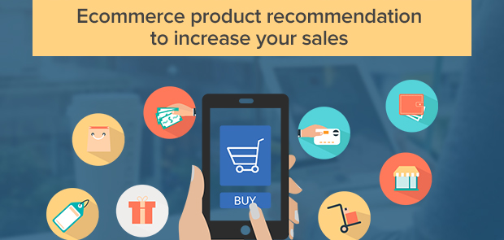
By:
Sowmya reddy baddam
Sri Harika Dungala
Pranay Nimmala

Slide 2
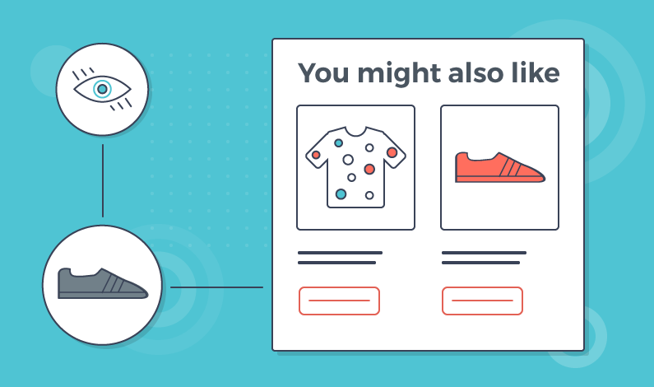
Why product recommendation
Time Constraints
Enhance user experience
Increase sales (most of the ecommerce organizations earn 35% of their revenue from recommendation. )

Slide 3
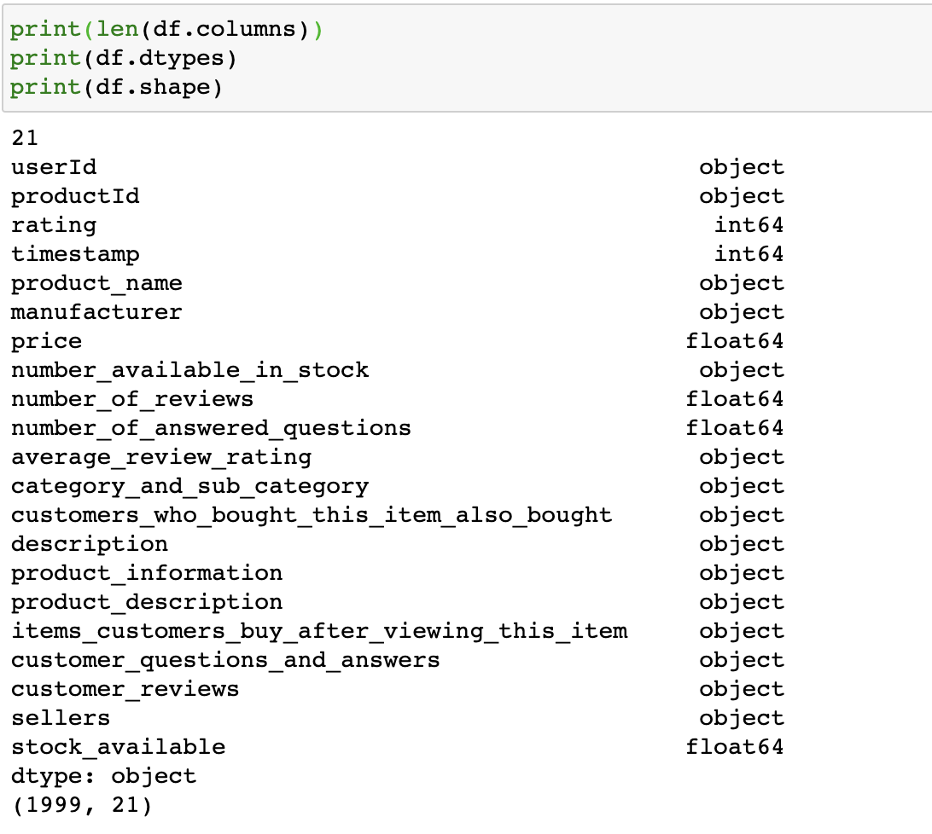
Understanding the data

Slide 4
Pre-processing
Extracting
Extracting numbers from strings
Checking
Checking column types & Converting Column types
Dropping
Dropping missing data and removing irrelavent columns

Slide 5

Types of recommendations used in our model
When a business is setting up its e-commerce website for the first time without any user’s history and their rating
Based on product details, we are finding the similarity between the products and recommending them to the users
Product popularity-based recommendation system targeted at new customers and based on the customers purchase history and their rating, we are comparing similar users and making recommendations.

Slide 6
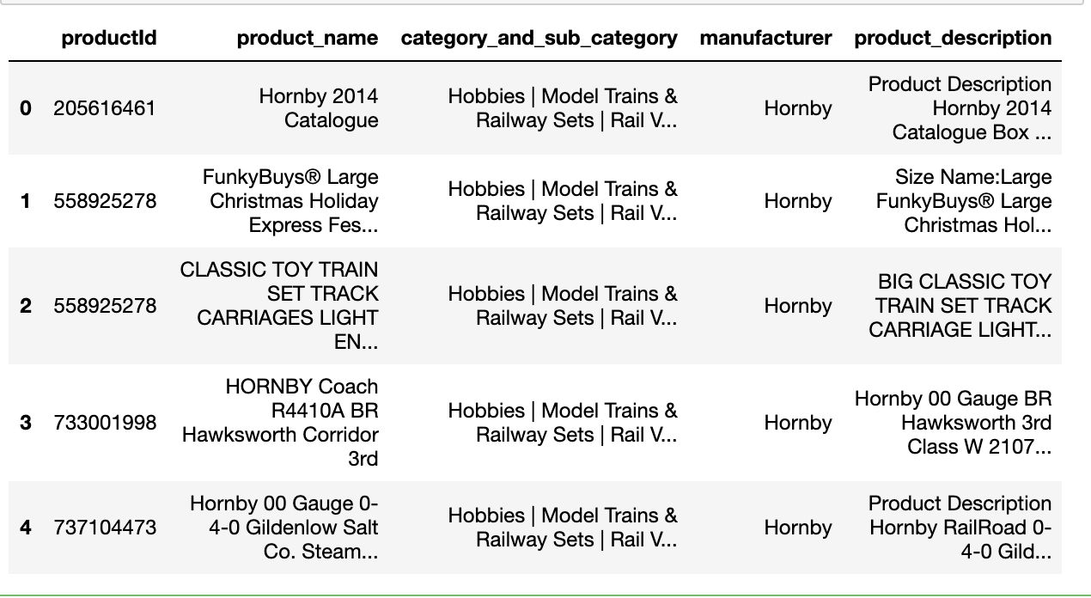
Recommendation 1
For a business without any user-item purchase history, a search engine based recommendation system can be designed for users. The product recommendations can be based on textual clustering analysis given in product description, product name and category.

Slide 7
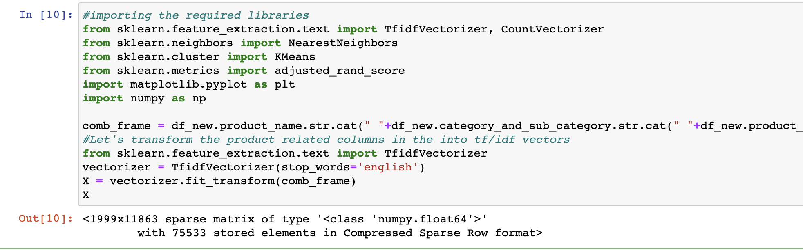
Recommendation 1
Feature extraction from product descriptions
Converting the text in product description into numerical data for analysis

Slide 8
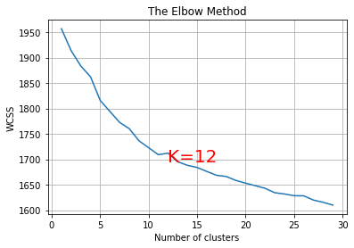
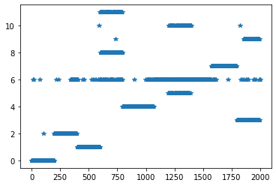
Recommendation 1
Using unsupervised learning.
With the help of KMeans we are clustering the all the similar group of words
With the help of elbow method we are finding total number of clusters

Slide 9
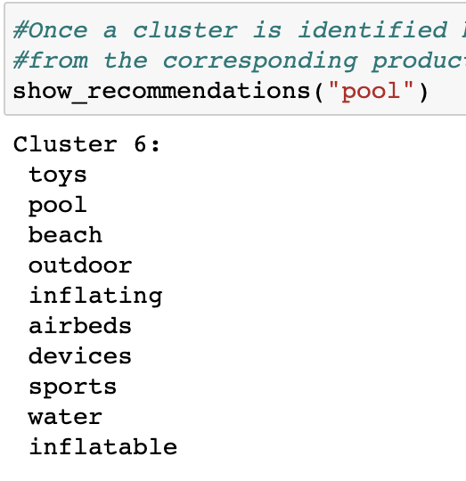
Recommendation 1
With the help of KMeans we are clustering the all the similar group of words
With the help of elbow method we are finding total number of clusters

Slide 10
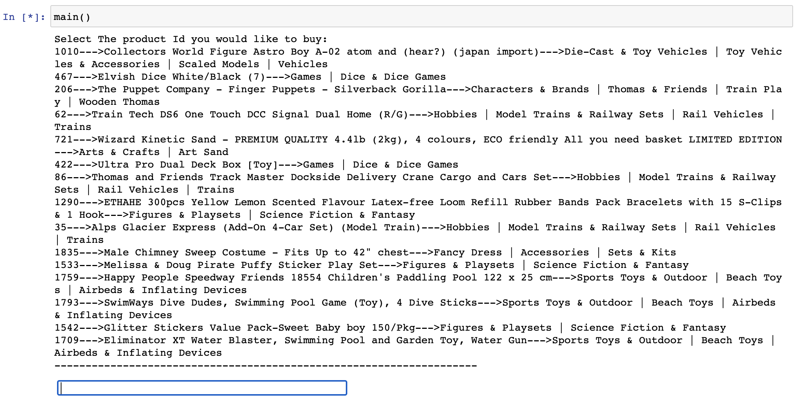
Recommendation 1
Once a cluster is identified based on the user's search words, the recommendation system can display items from the corresponding product clusters based on the product similarity.

Slide 11
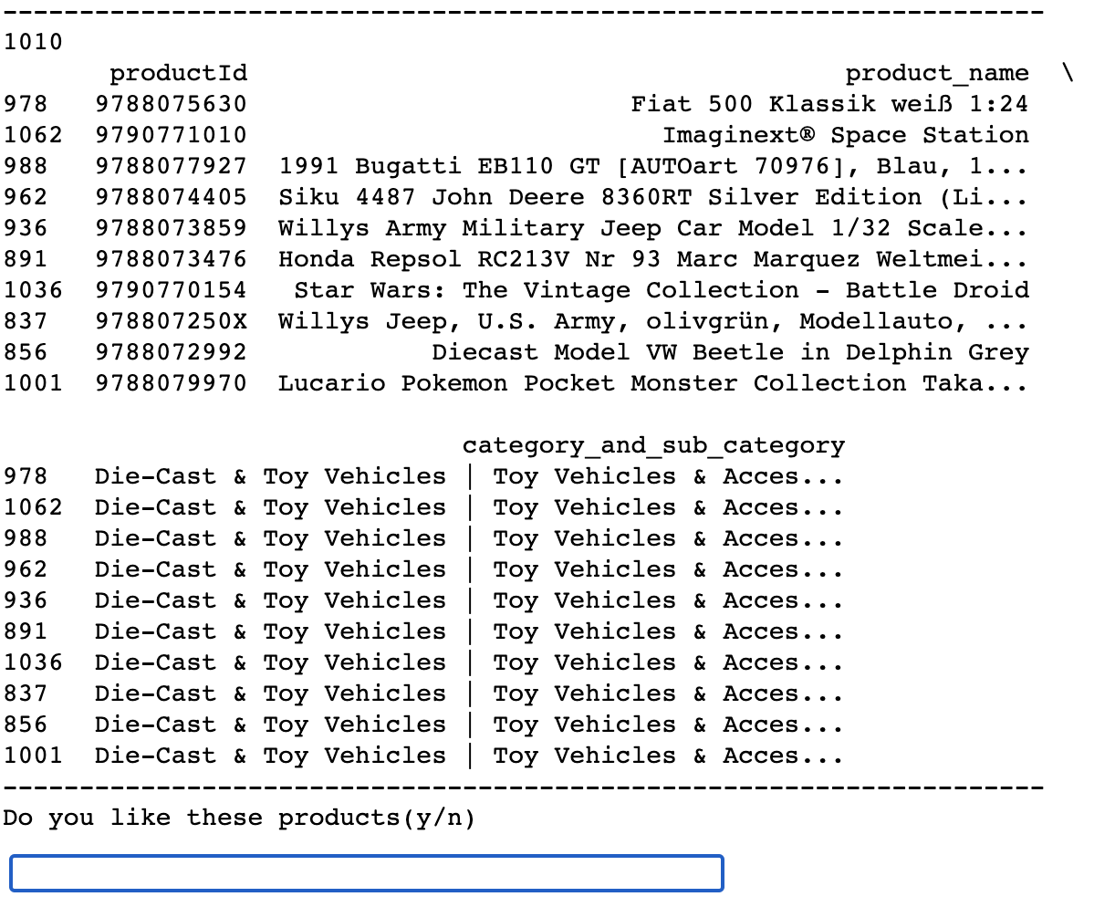
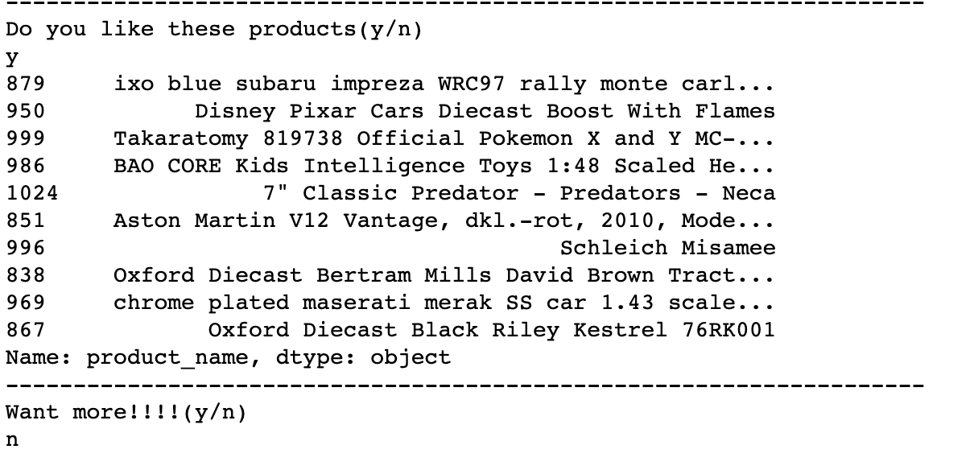
Recommendation 1
Once a cluster is identified based on the user's search words, the recommendation system can display items from the corresponding product clusters based on the product similarity.

Slide 12
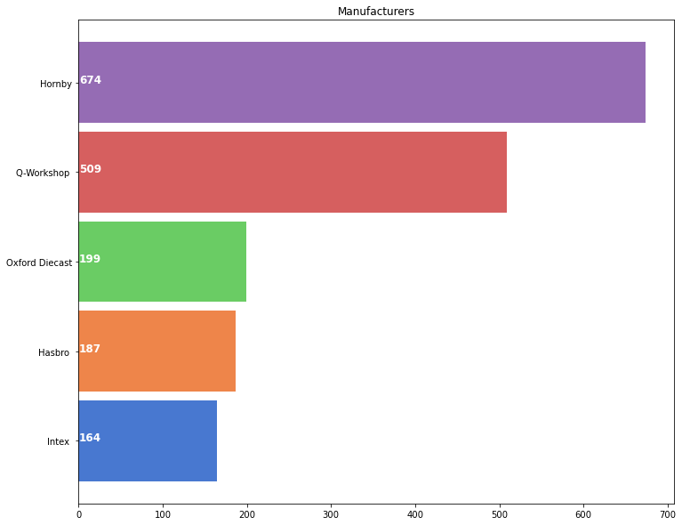
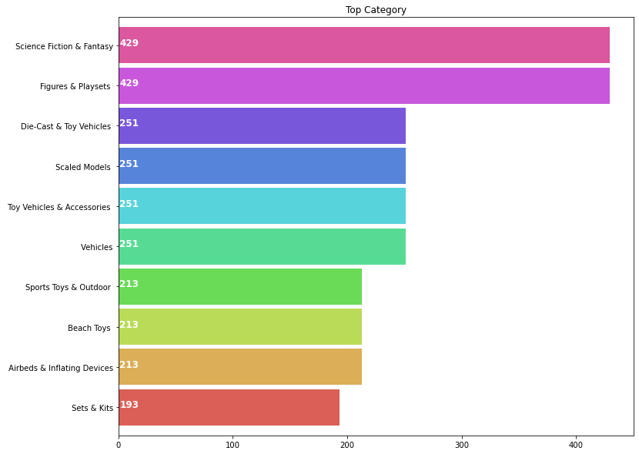
Recommendation 2
Based on product category and manufacturer, we are finding the similarity between the products and recommending them to the users
We are finding the similarity by finding the distance between the products.

Slide 13
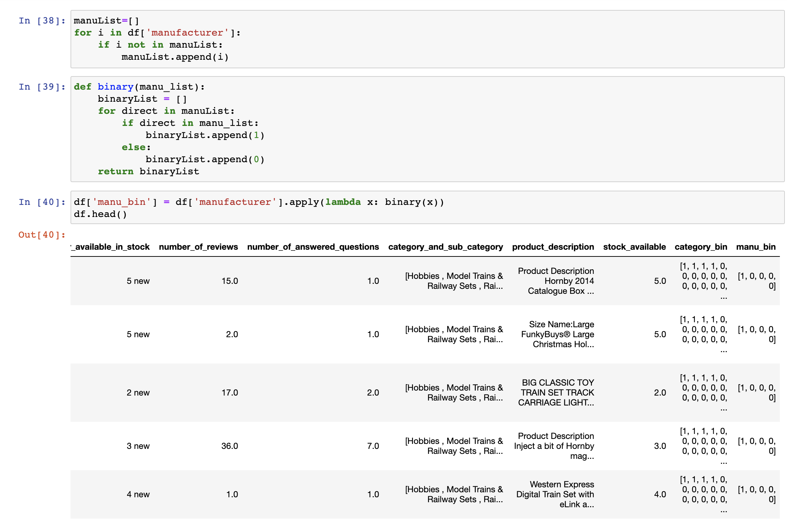
Recommendation 2
We converted the category and manufacturer column to numerical data using binary encoding.
In order to find the distance between the products, we are converted these columns to numerical.

Slide 14
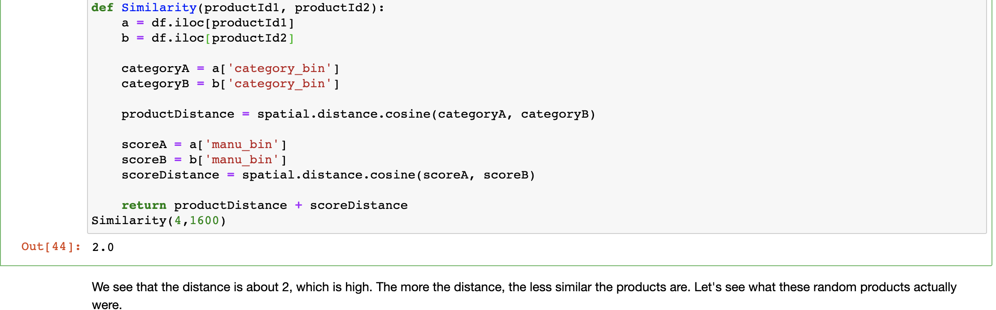
Recommendation 2
Cosine similarity is a metric, helpful in determining, how similar the data objects are irrespective of their size
If this distance is less, there will be a high degree of similarity, but when the distance is large, there will be a low degree of similarity.
Cosine similarity can be computed amongst arbitrary vectors. It is a similarity measure (which can be converted to a distance measure, and then be used in any distance-based classifier, such as nearest neighbor classification.)

Slide 15
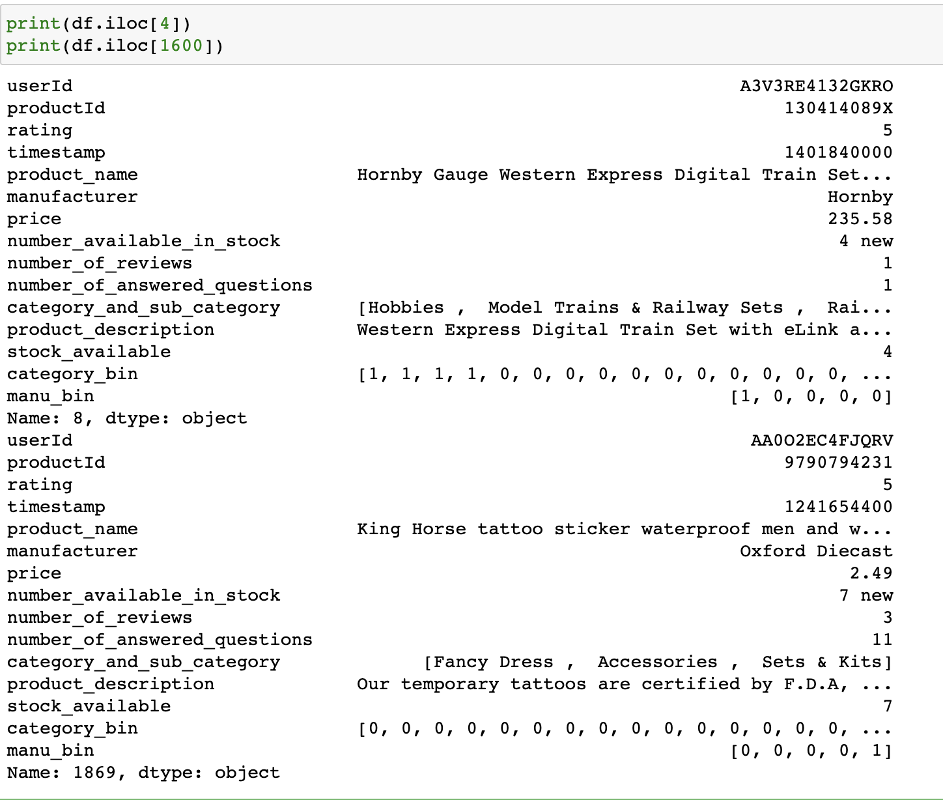
Recommendation 2
We see that the distance is about 2, which is high. The more the distance, the less similar the products are. Let's see what these random products actually were.
It is evident that Hornby Gauge Western Express Digital Train Set and The Amazing Spiderman Stickers 2 are very different products with differnt category and manufacturer. Thus the distance is huge.

Slide 16
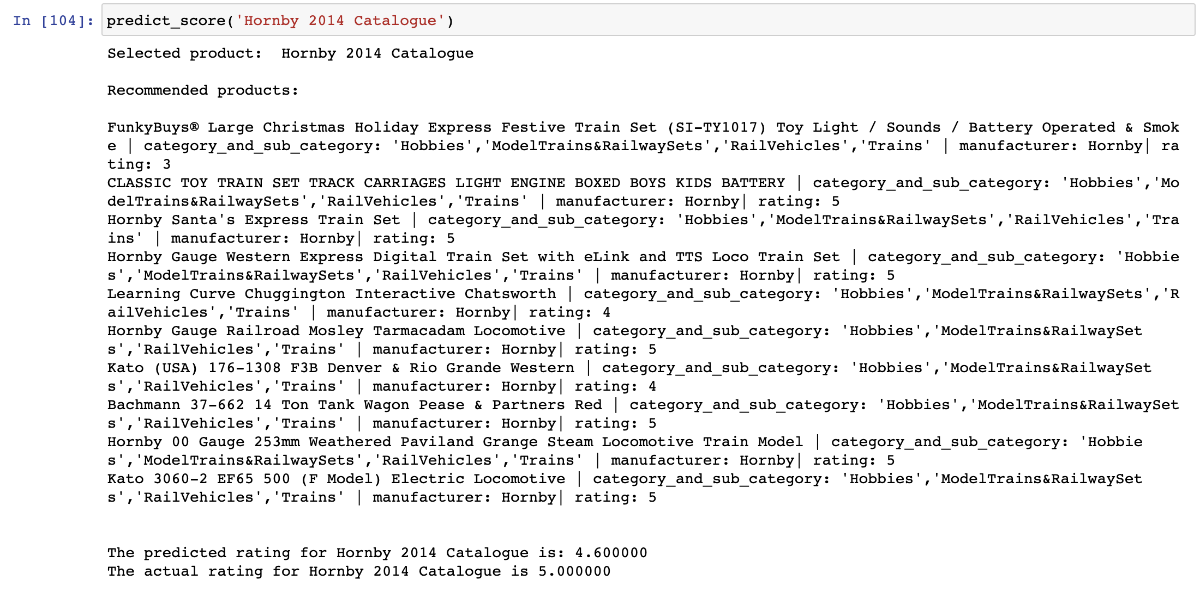
Recommendation 2
Recommendation System by implementing the K-Nearest Neighbors algorithm. Predicting the rating of the given product based on its neighbors and compare it with the actual rating
After finding the distance we are using supervised model, K-Nearest Neighbors to find the 10 nearest products that are similar

Slide 17
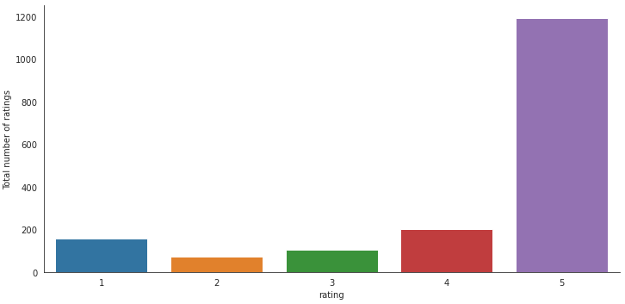
Recommendation 3
Product popularity based recommendation system targeted at new customers
Looks like a very high proportion of ratings received is either 5 or 4. Next highest count of ratings received is for 1 which is still a very high number (=100000).
Lets compare the average rating for each product vs the number of people who rated for the product.

Slide 18
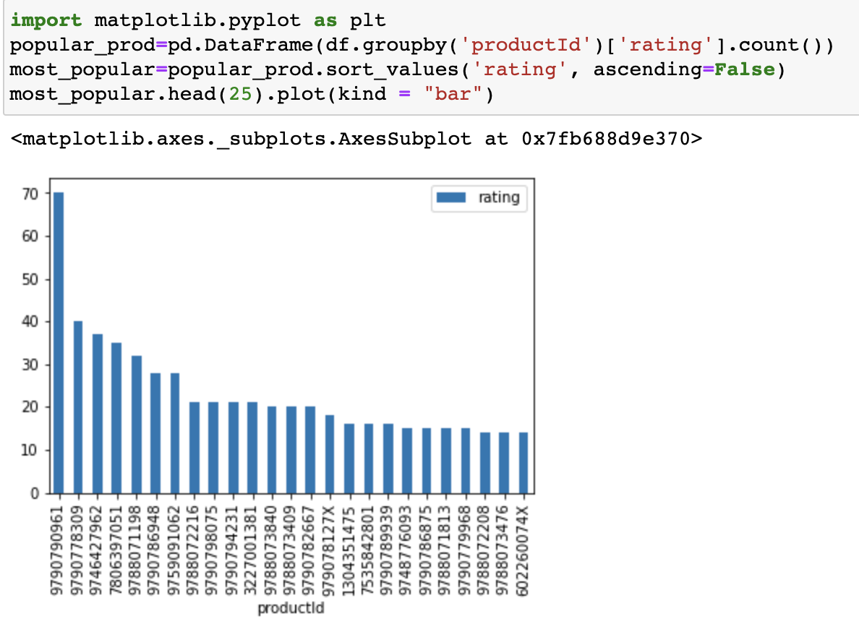
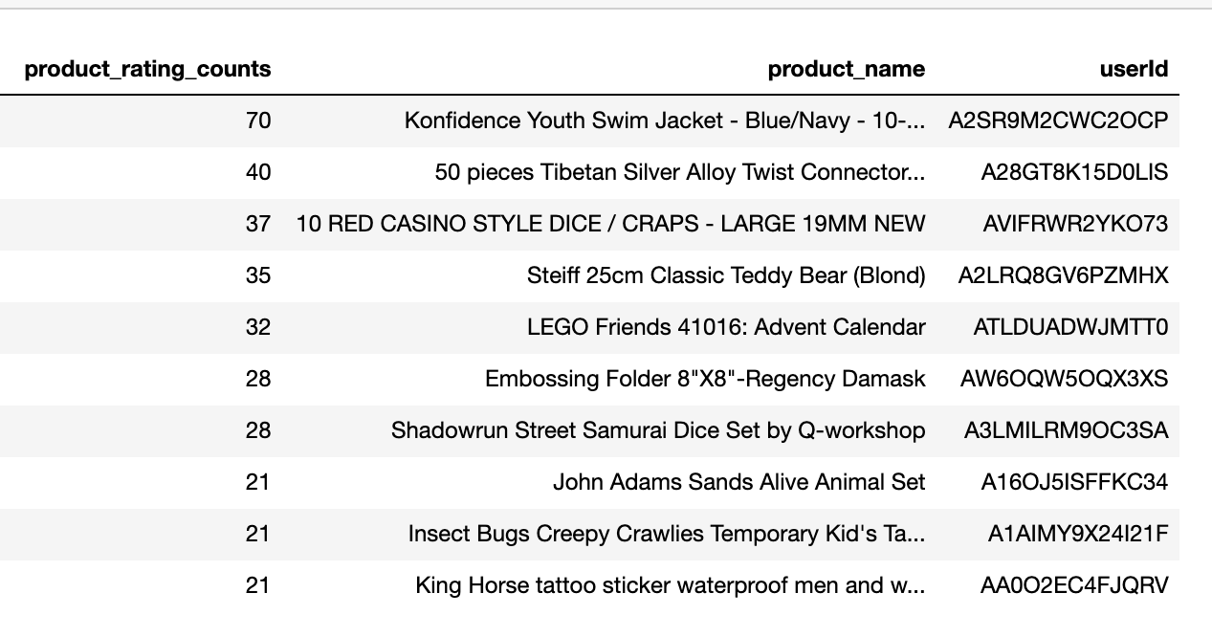
Recommendation 3
Looks like the productid (97907909613) got the maximum number of rating hence it is the most popular product

Slide 19
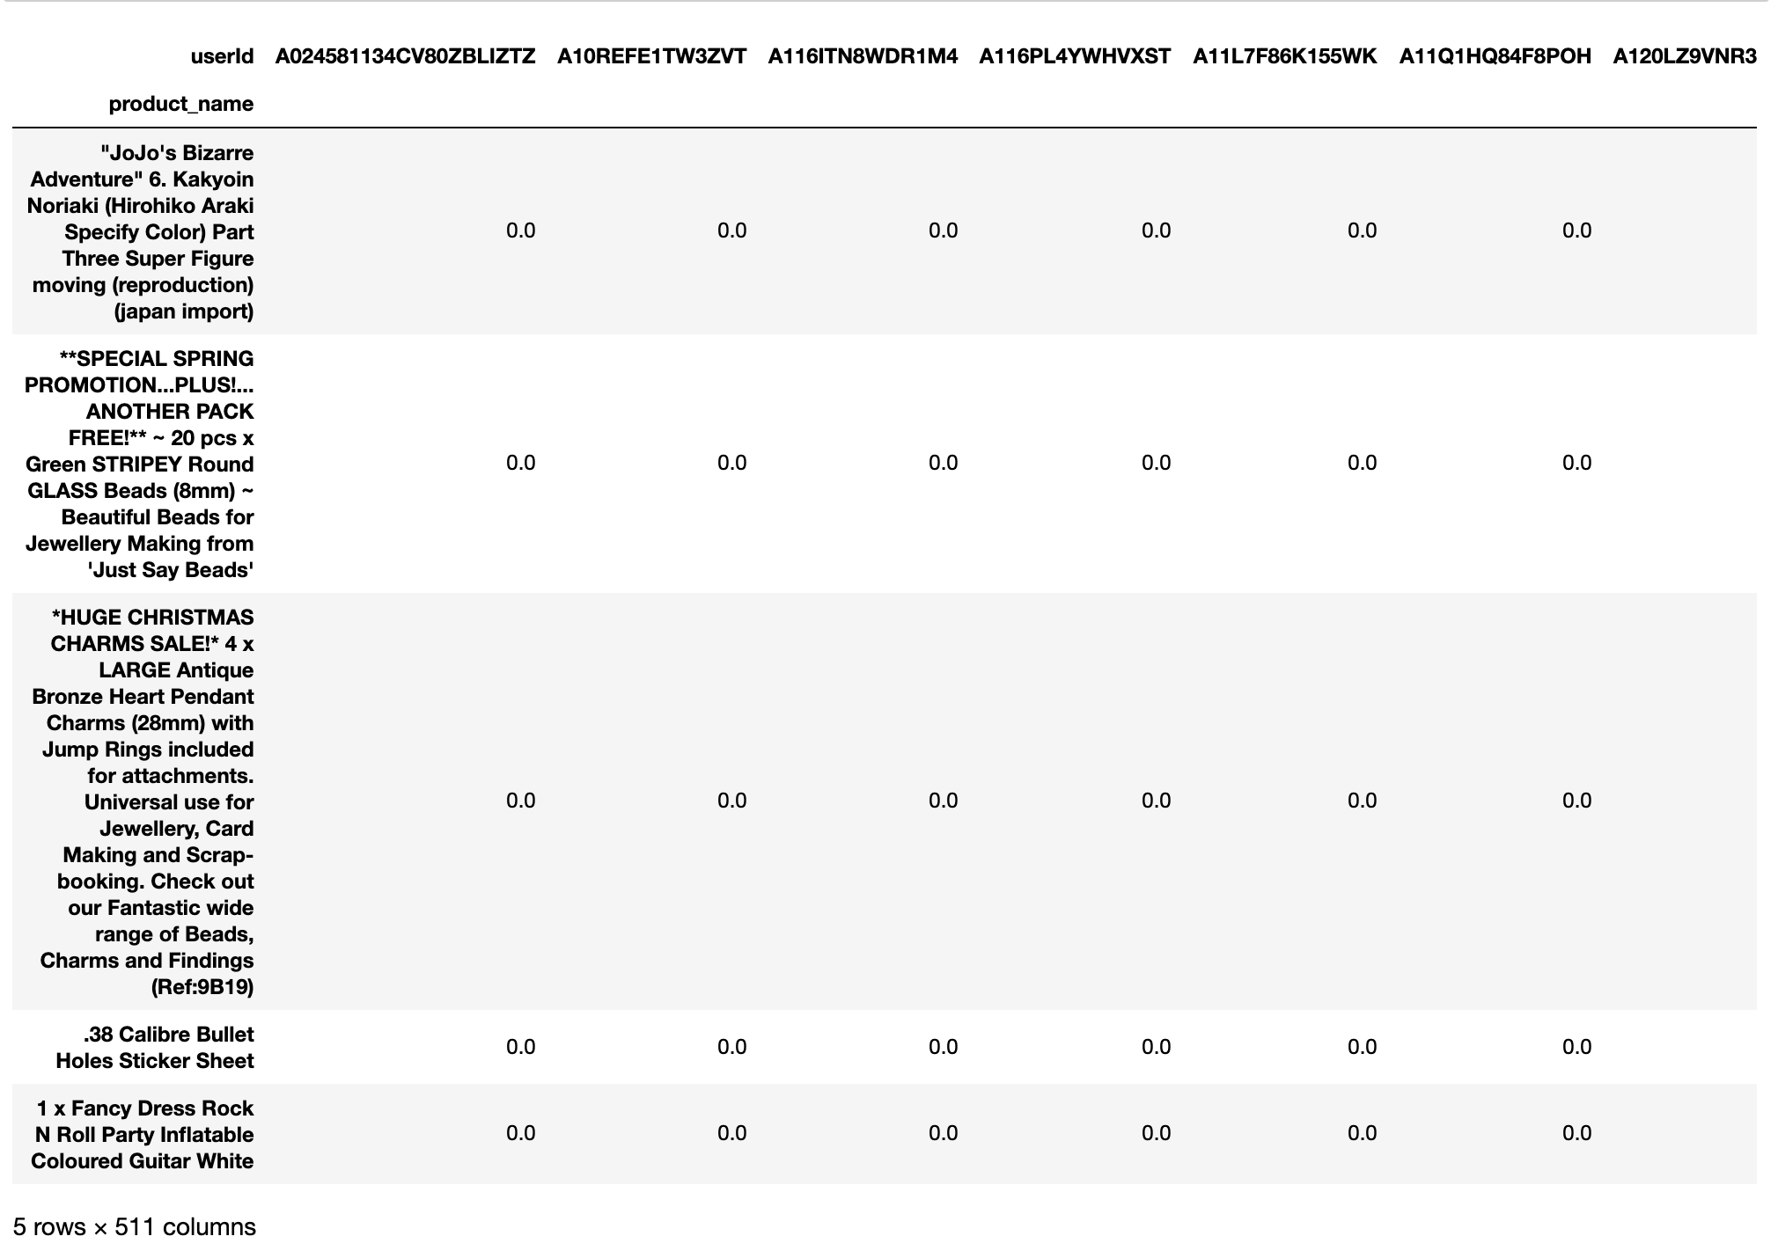
Recommendation 3
Based on the customers purchase history and their rating, we are comparing similar users and making recommendations.
We first present ratings in a matrix, with the matrix having one row for each item (product_name) and one column for each user
We convert our table to a 2D matrix, and fill the missing values with zeros (since we will calculate distances between rating vectors). We then transform the values(ratings) of the matrix dataframe into a scipy sparse matrix for more efficient calculations

Slide 20
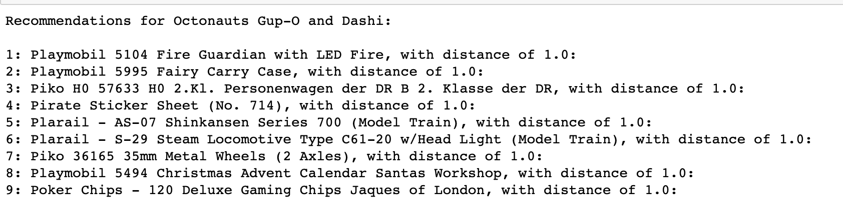
Recommendation 3
We use sklearn.neighbors algorithm. The algorithm we use to compute the nearest neighbors is “brute”, and we specify “metric=cosine” so that the algorithm will calculate the cosine similarity between rating vectors. Finally, we fit the model.
We then find the k item that have the most similar user engagement vectors
In this step, the kNN algorithm measures distance to determine the “closeness” of instances. It then classifies an instance by finding its nearest neighbors and picks the most popular class among the neighbors.
The principle behind nearest neighbor methods is to find a predefined number of training samples closest in distance to the new point and predict the label from these.

Slide 21


Slide 22


Slide 23


